Slide 1
QuantConnect Alpha Strategy
Bringing algo-trading closer to non-professional investors
Batch 3A – Group 1

Slide 2
Roadmap
Survey
Python
QuantConnect
Refine trading strategies
Trading
Proprietary
Capital
(Income Source 2)
1
3
5
2
4
6
Development of long and short term trading strategy
Submit on Alpha Stream
(Income Source 1)
Fund Management
Business
(Income Source 3)

Slide 3
1.Trading Strategy as a Service

Slide 4
New Way of Trading/Investing
Professional trading/investment
QuantConnect
Alpha Market
Personal trading/investment
QuantConnect is a platform for :
Algo-Trading;
Analytics/Research;
Trading strategy marketplace.

Slide 5
2.Understanding our client

Slide 6
Our Client
The persona :
reached legal age to open trading account.
generally, not savvy traders or investors.
aware what are stocks or share markets about.
looking to invest idle funds to generate risk adjusted returns from trading, at least beating inflation rate.
looking to invest in liquid assets classes or financial instruments using strategies which can be repeated over time to generate returns.
looking for strategies which emphasize capital appreciation & growth

Slide 7
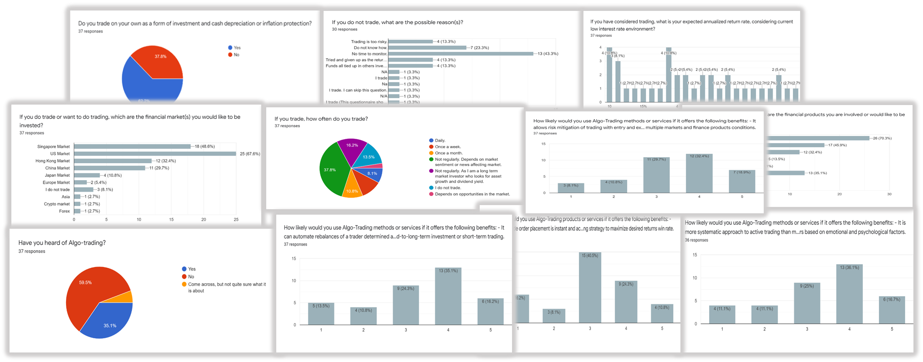
Survey Questionnaires
Total 37 responses are obtained.

Slide 8
Understanding Our Client
From survey:
about 62%, does trading as a form of investment inflation protection.
most cited reason for not trading or actively involved in trading is lack of time to monitor trades.
68%, expected to achieve an annualized return of 3% to 10%, with 18% expecting above 10% to 20% return.
68%, has shown interest in US market for trading.
instruments of interest :- 1) Equities, 2) ETFs, 3) Crypto-currencies 4) REITs
Only about 35% knows about Algo-trading.

Slide 9
Survey Insights
time for monitoring markets as main factor for not involved in trading or engage in it frequently.
shown high interest in US market, which offered relatively most liquid and choices of trading instruments.
most does not know about algo-trading, about half is likely to engage in one, when told of its benefits, in particular:
allow systematic approach to active trading than methods based on individual’s intuition or instinct.
reduce possibility of human mistakes in trading based on emotional and psychological factors.

Slide 10
Further Insights
Probing 4 persons with algo-trading knowledge:
preferred subscription fee level USD 3-5 per month (per USD 10K invested).
expected annualized return rate - 5% to 10%.
strategy to execute at least once a week or a month.
concern about strategy’s capability and effectiveness in meeting profitability target.
options of types of instruments based on risk appetite.
to know instruments’ measure of volatility, back-tested Sharpe ratio and absolute returns.
strategy that would consider time & volume weighted average price.

Slide 11
3. QuantConnect Alpha Market
A typical case of strategy selection

Slide 12
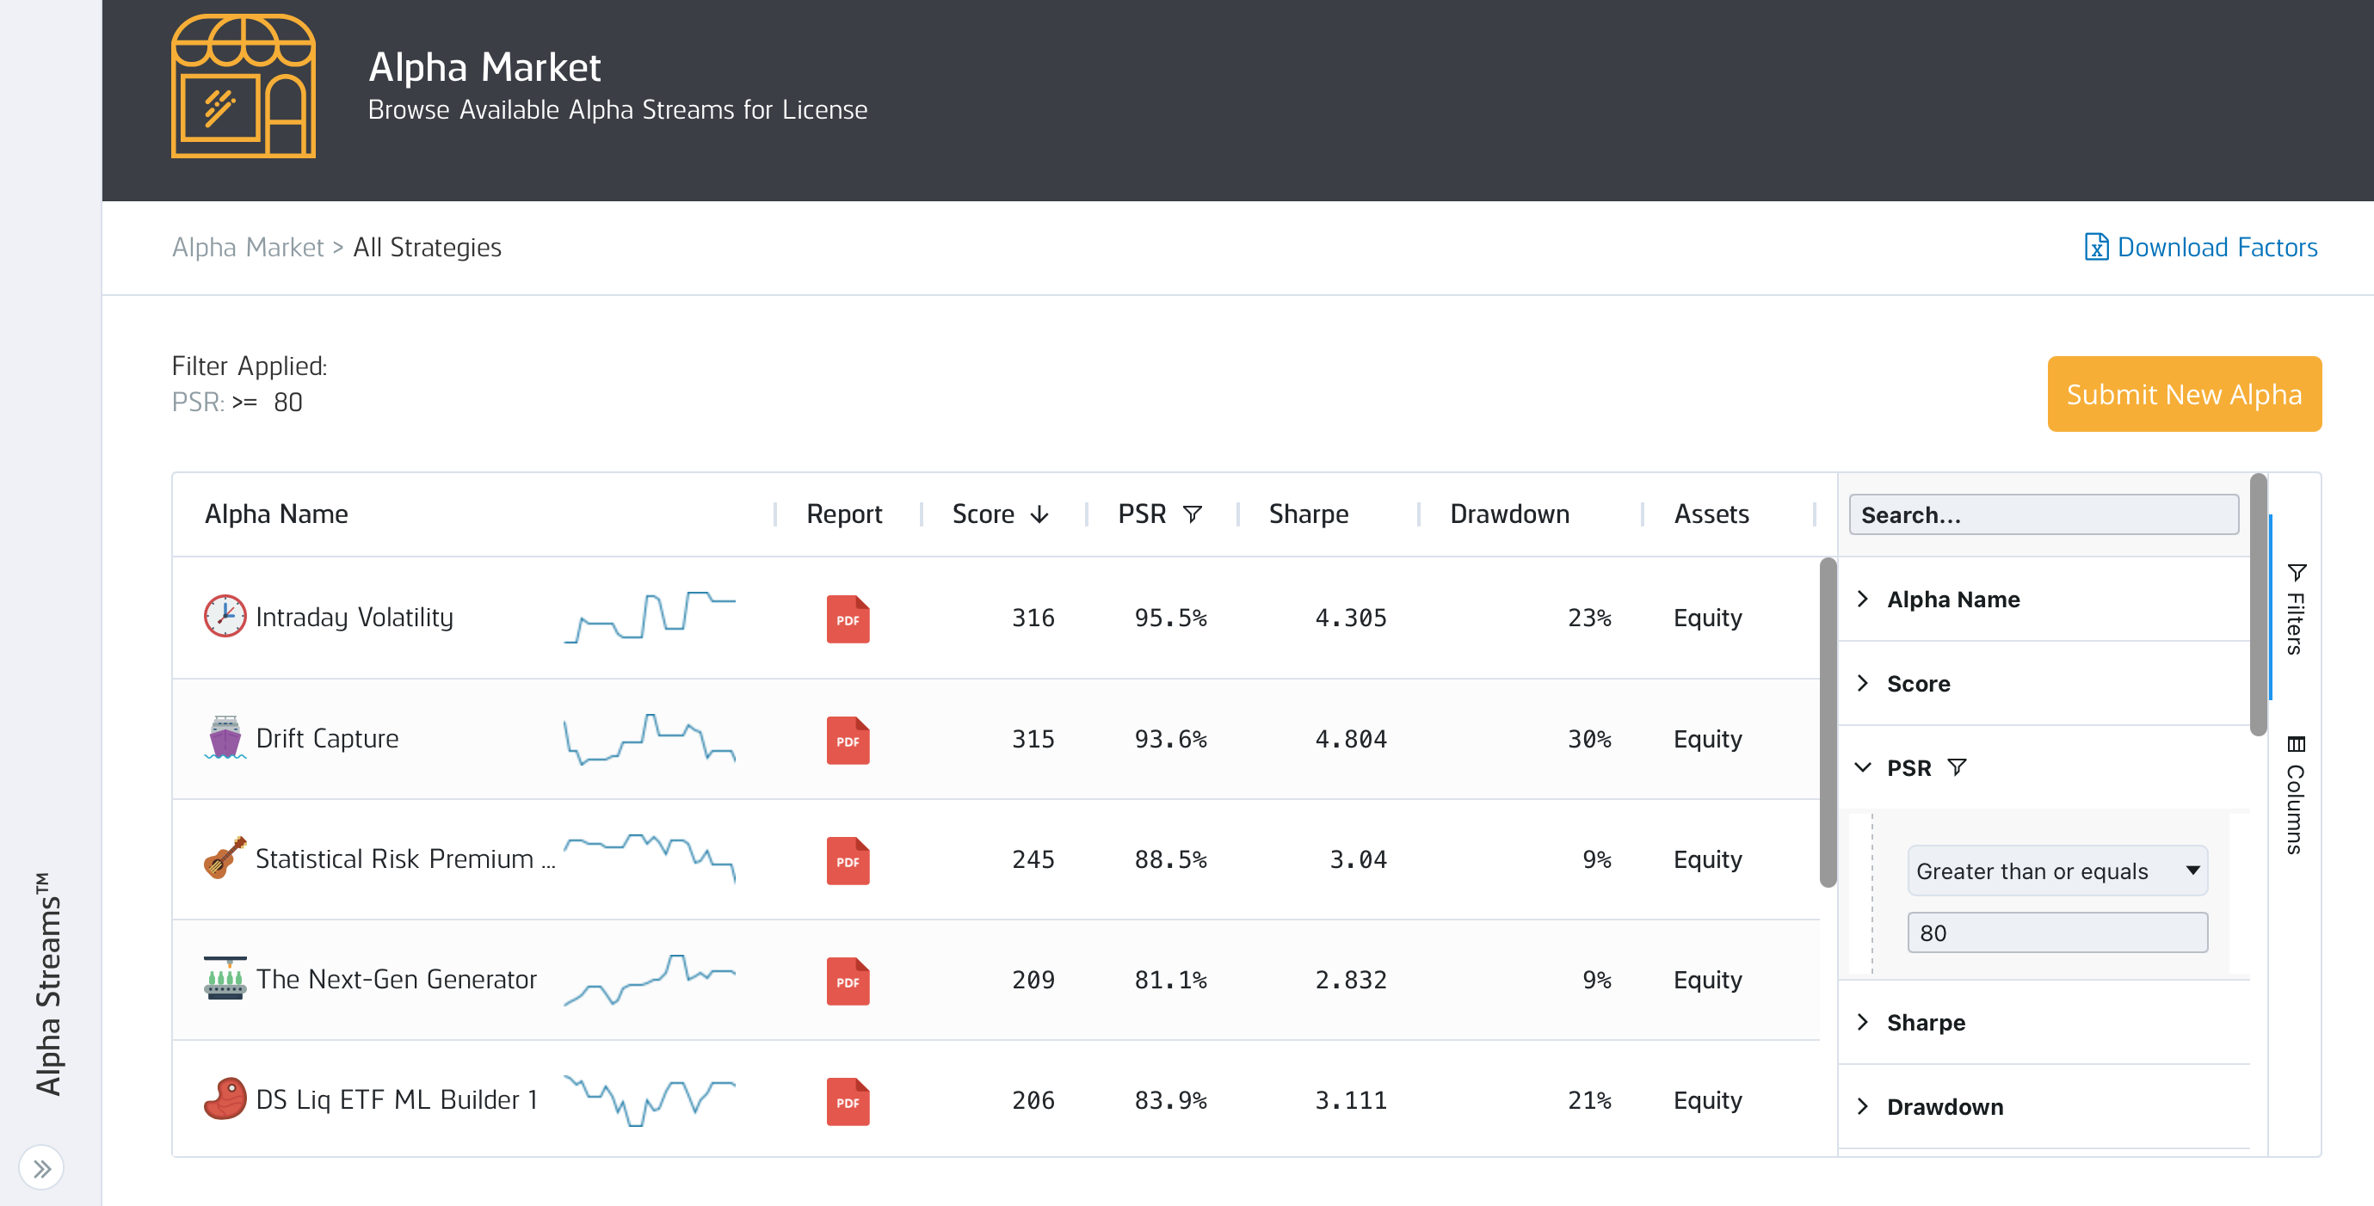
Strategy selection on Alpha Market

Slide 13
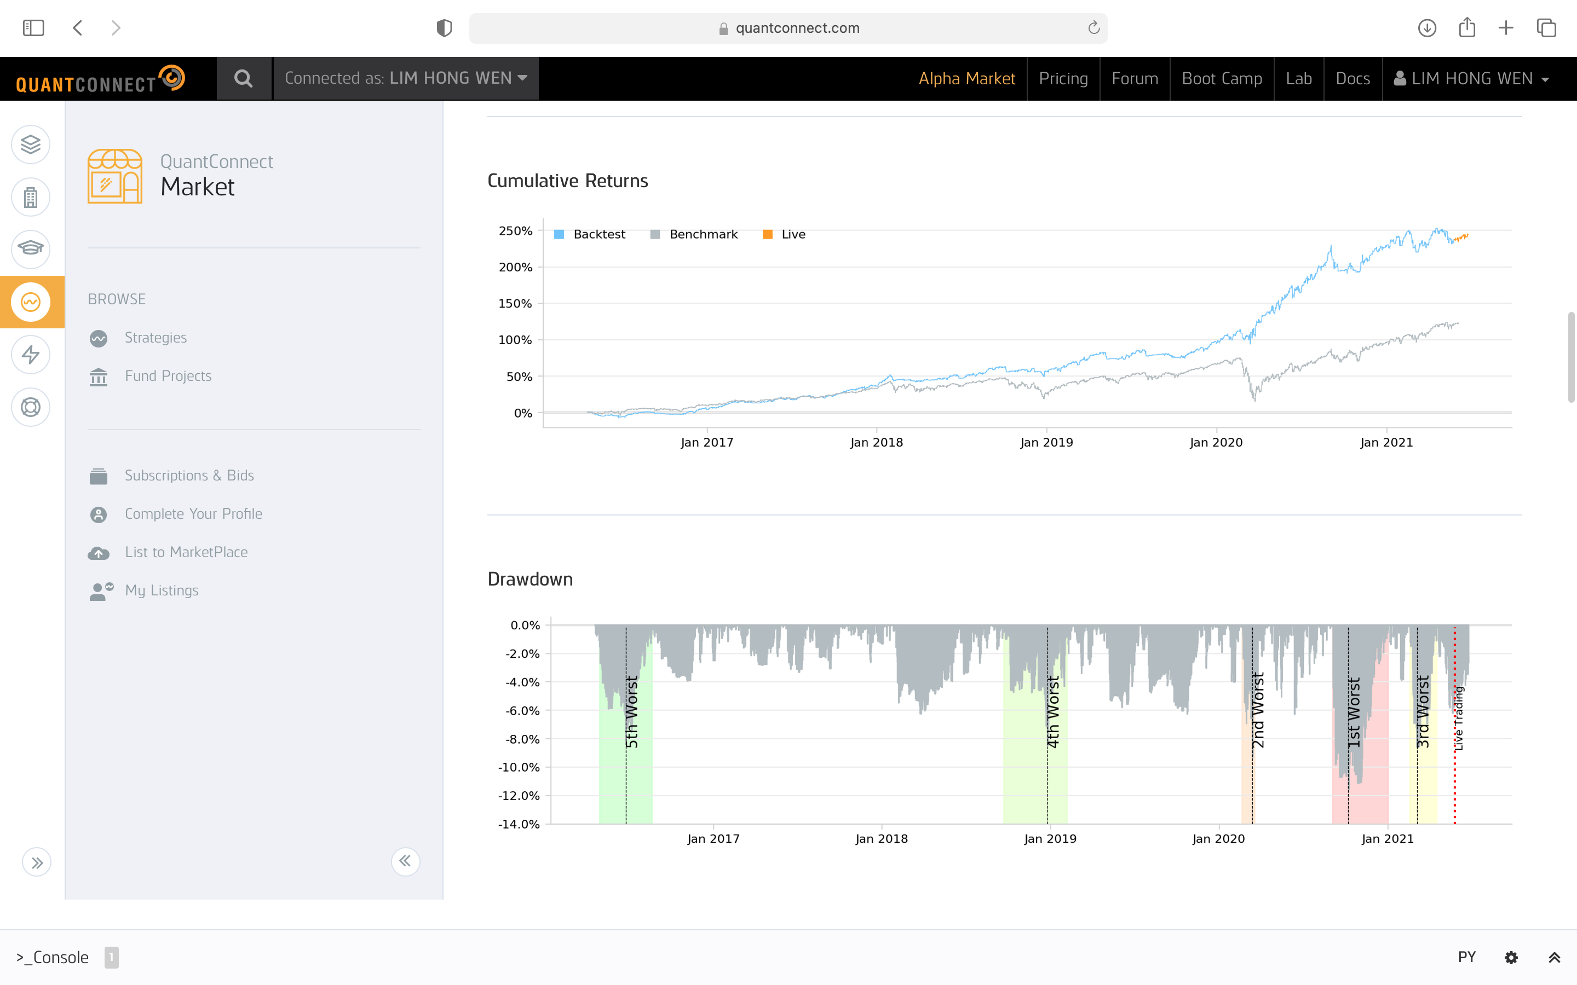
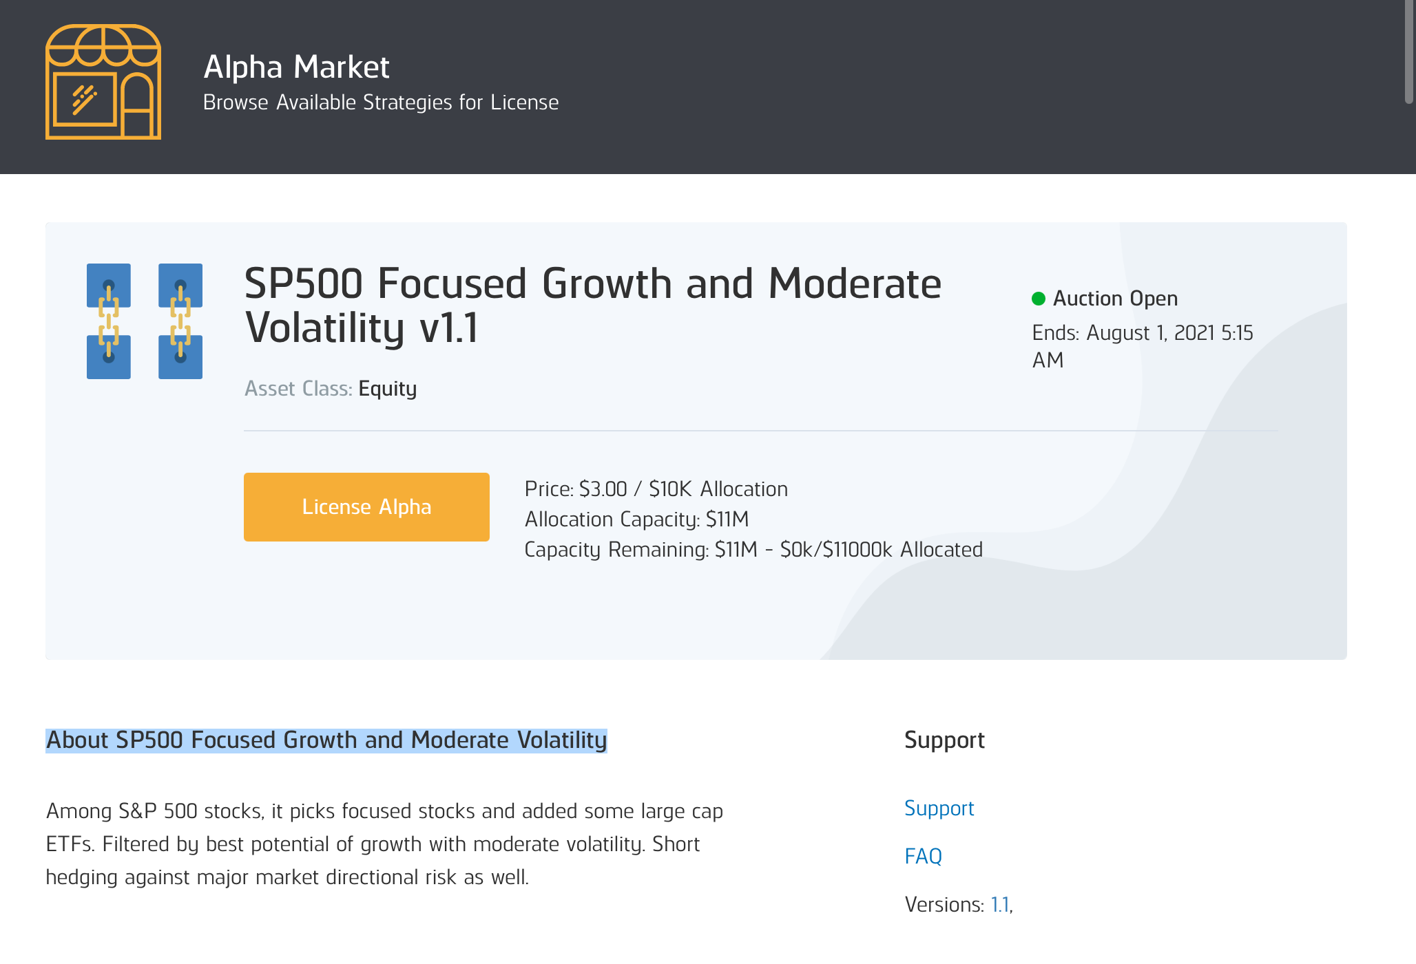
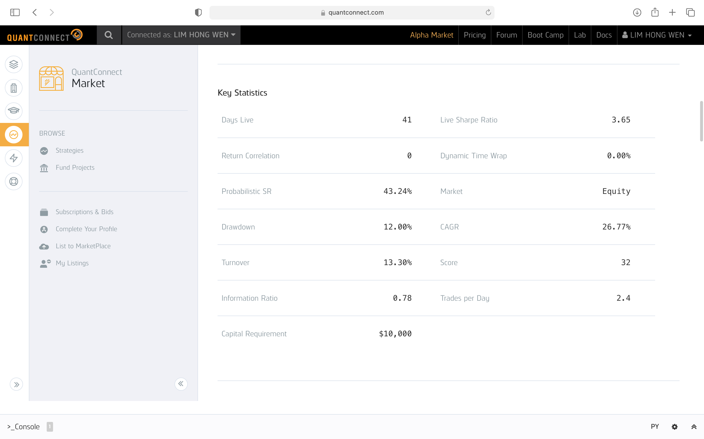
Example of a strategy

Slide 14
4. Our Solution

Slide 15
Our solution
Simple MACD based;
Optimize MACD parameters for 20+ symbols
Trailing stop loss;
Daily
Actively monitor several symbols;
Allocate 3 “best” out of 7 US stocks
Short Term Trading Strategy
Long Term Portfolio Allocation Strategy
SP500 based “11-sector-rebalance”

Slide 16
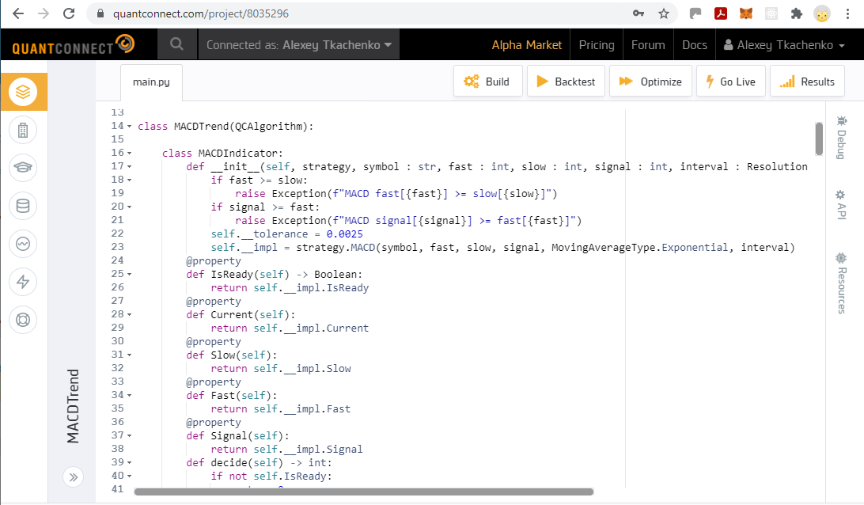
Short term trading strategy
The code is available at Github :
https://github.com/iskaspb/project-omega/blob/master/src/strategy/MACDTrend/main.py

Slide 17
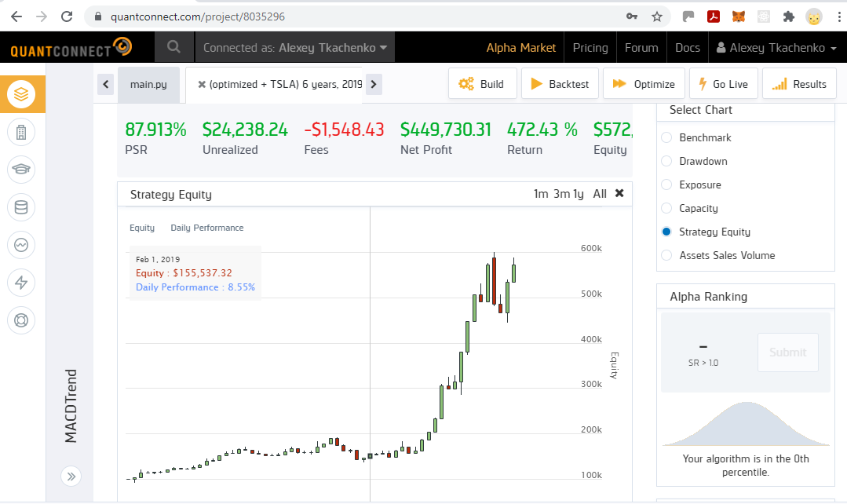
Short term trading strategy backtest

Slide 18
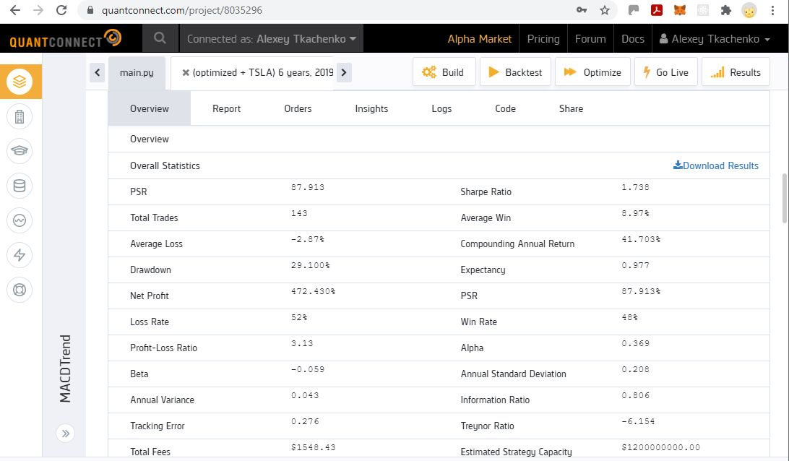
Short term trading strategy backtest

Slide 19
Backtest results
 | Annual Return | Sharpe Ratio | PSR
Short Term Trading Strategy 6 year (3 out of 7 US stocks) | 18.8% | 0.9 | 28%
Short Term Trading Strat (Optimized) 6 years (3 out of 7 US stocks) | 41.7% | 1.7 | 88%
Long Term Portfolio Allocation Strategy 6 years | 14.1% | 0.77 | 23.3%
SP500 6 years | 12.6% | 0.7 | 19.2%

Slide 20
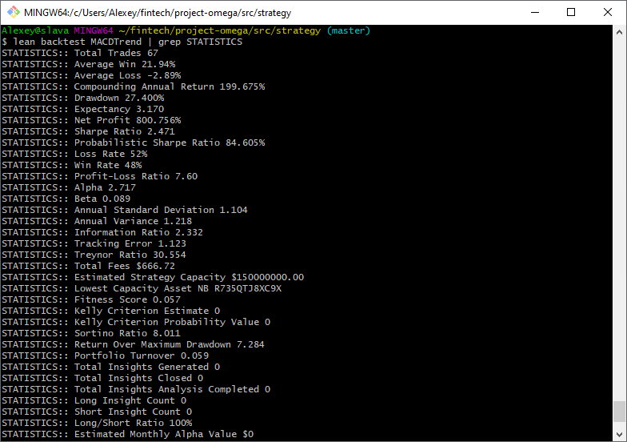
QC Lean : research environment
Benefits
Free of charge;
Automation;
Custom data sources;
Integration with cloud environment;
Convenience of local development and simple to install - see out Github omega-project
QS Lean provides command line interface to all strategy development functions

Slide 21
5. Financials

Slide 22
Financials
48600
Alpha Market Revenue Assumptions
Licensing fee @$3 per month or $36pa per strategy per client (for each 10K invested).
Yr 1
3 strategies with an average of 10 clients each.
Yr 2:
Another 3 strategies added. Total of 6 strategies with an average of 20 clients each.
Yr3
Another 3 strategies added. Total of 9 strategies with an average of 30 clients each
X5
21600
X5
5400
X5
Proprietary trading @20% on $50,000 = $10,000 per annum

Slide 23
Conclusion
Adopted QC Lean and developed set of tools to achieve consistent trading strategy R&D process.
Challenging to develop strategies for Alpha market.
Income from licensing fee strategies not substantial.
Given us insights as investors into algo trading.

Slide 24
Q & A

